Slide 1
DRUG INTERACTIONS
Dr. Priti Patel

Slide 2
DEFINITION Drug interaction can be defined as the modifications of the effects of one drug by the prior or concomitant administration of another drug.

Slide 3
The Drug whose Activity is effected by such an Interaction is called as a “Object drug.”
The agent which precipitates such an interaction is refered to as the “Precipitant”.

Slide 4
Factors contributing to drug interactions:
1.Multiple drug therapy.
2.Multiple prescribers.
3.Multiple pharmacological effects of drug.
4.Multiple diseases/predisposing illness.
5.Poor patient compliance.
6.Advancing age of patient.
7.Drug-related factors.

Slide 5
Types of drug Interactions
DI
Drug -Food
Drug-Drug
Drug-Disease
Drug-Herbal
Drug-Alcohol

Slide 6
The Net effect of a Drug Interaction is:
Generally quantitative i.e.increased or decreased effect.
Seldom qualitative i.e.rapid or slower effect.
Precipitation of newer or increased adverse effect.

Slide 7
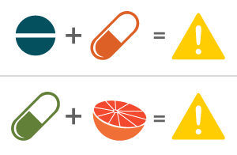
Drug interactions are thus-
Mostly undesirable
Rarely desirable(beneficial):
for eg., enhancement of activity of penicillins when administered with probenecid.

Slide 8
Mechanisms of drug interactions:
The three mechanisms by which an interaction can develop are-
1.Pharmaceutical interactions.
2.pharmacokinetic interactions.
3.Pharmacodynamic interactions.

Slide 9
Drug - Drug Interactions
DI
Outside the body
Syringe
Iv fluids
Inside the body
Pharmacokinetic
Pharmacodynamic
Pharmaceutical Interactions

Slide 10
Pharmaceutical interactions:
Also called as incompatibility.it is a physicochemical interaction that occous when drugs are mixed in i.v . Infusions causing precipitation or inactivation of active principles .
Example:-
Ampicillin, chlorpromazine & barbituates interact with dextran in solutions and are broken down or from chemical compounds.

Slide 11
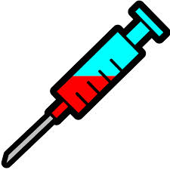
Mixing of the drugs in the same syringe
1. Thiopentone and succinylcholine.
2. Carbenicillin inactivate aminoglycosides.
3. Hydrocortisone inactivates penicillins.

Slide 12
Stability of drugs in Saline or Dextrose solution
Unstable Infuse within 2-4hrs | Stable for 6-8 hrs | Stable for 12 hrs | Photosensitive drugs | Not infused after 6 hrs
Ampicillin | Benzyl penicillin | Fluoxacillin | Amphoterecin | Cephaloridine
Erythromycin | Diazepam | Tetracycline | Dacarbazine | colistin

Slide 13
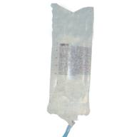
Prevention of Pharmaceutical Interactions
Give iv drugs by bolus.
Do not add infusion solutions.
Avoid mixing of drugs in the same infusion.
Use 2 separate infusion sites if drugs administered simultaneously .

Slide 14
Pharmacokinetic Interactions:
“These interactions are those in which ADME properties of the object drug is altered by the precipitant and hence such interactions are also called as ADME interactions”.
The resultant effect is altered plasma concentration of the object drug.
These are classified as:
1.Absorption interactions
2.Distribution interactions
3.Metabolism interactions
4.Excretion interactions.

Slide 15
Absorption interactions
.
Are those where the absorption of the object drug is altered. The net effect of such an interaction is:
Faster or slower drug absorption.
More, or, less complete drug absorption.

Slide 16
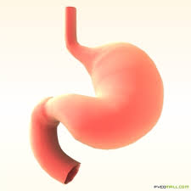
Major mechanisms of absorption interactions
Alteration in gut motility
Surface area : Malabsorption syndrome
Complexation and adsorption
Alteration in GI pH
Alter
Intestinal flora
Alter drug transporters
Inhibition of GI enzymes

Slide 17
OBJECT DRUG | PRECIPITANT DRUGS |  | INFLUENCE ON OBJECT DRUG
ABSORPTION INTERACTION COMPLEXATION & ADSORPTION
CEPHROFLOXACINE, PENCILLAMINE |  | ANTACIDS,FOOD & MINERALS SUPPLEMENTS CONTAINING AL,Mg,Fe,Zn & Ca IONS |  | FORMATION OF POORELY SOLUBLE AND UNABSOBABLE COMPLEX WITH SUCH HEAVY METAL IONS.
ALTERATION OF GI PH
SULPHONAMIDES, ASPIRIN FERROUS SULPHATE |  | ANTACIDS SODIUM BICARBONATE,CALCIUM CARBONATE |  | ENHANCED DISSOLUTION AND ABSORPTION RATE. DECREASED DISOLLUTION AND HENCE ABSORPTION.
ALTERATION OF GUT MOTILITY
ASPIRIN DIAZEPAM, LEVODOPA, MEXILETINE |  | METOCLOPRAMIDE |  | RAPID GASTRIC EMPTYING,INCREASED RATE OF ABSORPION.
LEVODOPA, LITHIUM CARBONATE, MEXILETINE |  | ANTI CHOLINERGICS |  | DELAYED GASTRIC EMPTYING;DECREASED RATE OF ABSORPTION.

Slide 18
OBJECT DRUG | PRECIPITANT DRUGS |  | INFLUENCE ON OBJECT DRUG
ALTERATION OF GI MICROFLORA
DIGOXIN |  | ANTI BIOTICS |  | INCREASED BIOAVAILABILITY DUE TO DESTRUCTION OF BACTERIAL FLORA THAT INACTIVATES DIGOXIN IN LOWER INTESTINE.
MALABSORPTION SNDROME
VITAMIN A,B12,DIGOXIN |  | NEOMYCIN |  | INHIBITION OF ABSORPTION DUE TO MAL.

Slide 19
Surface area
Drug-induced mucosal damage.
Antineoplastic agents: e.g., cyclophosphamide
vincristine
procarbazine
Inhibit absorption
of several drugs
eg., digoxin

Slide 20
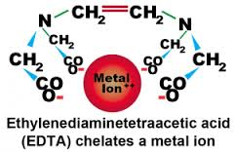
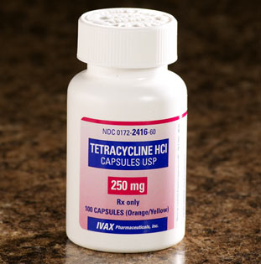
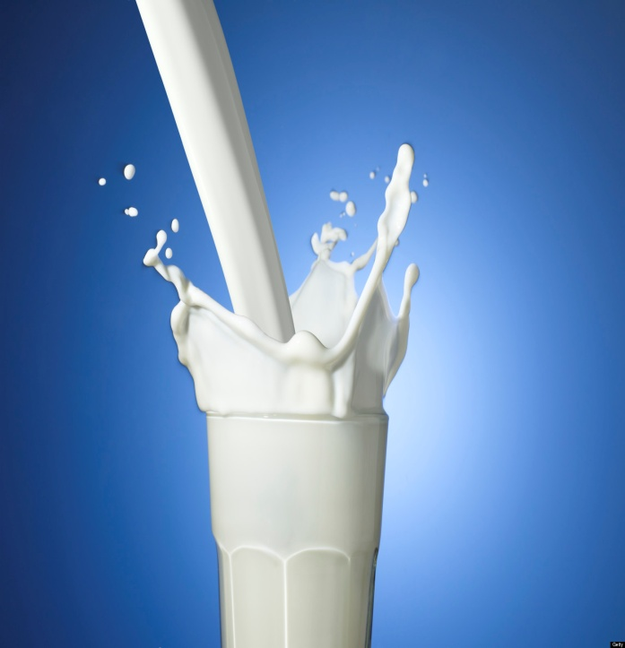
Chelation and Complexation
Al ³⁺ , Mg ²⁺ + Prednisolone → Insoluble Complexes
Ca²⁺ + TC → Formation of chelating compounds

Slide 21
Decrease absorption of
ciprofloxacin by 85%
due to chelation
Antacid (aluminum or magnesium hydroxide)
Cholestyramine + Digoxin and Warfarin
(Resin)
BA of Digoxin and Warfarin
Renal clearence of bicorbonate resulting in systemic acidosis
Sodium polystyrene + cations

Slide 22
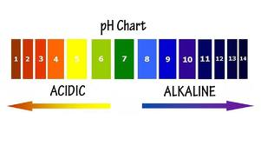
Alteration in pH
The non-ionized form of a drug is more lipid
soluble and more readily absorbed from GIT than the
ionized form does.
PH
Absorption of
weak acids
PH
Absorption of weak bases

Slide 23
antacids
Decrease the tablet dissolution
of Ketoconazole (acidic)
Increases absorption of weak bases like
Anti coagulents, warfarin, phenyl butazone
H2 antagonists
Therefore, these drugs must be separated by at least 2h
in the time of administration of both .

Slide 24
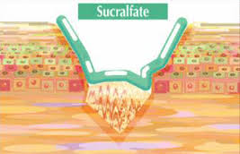
Forming an adsorptive layer
Cholestyramine inhibits absorbtion of Digoxin, warfarin
Sucralfate interferes with absorbtion of Phenytoin

Slide 25
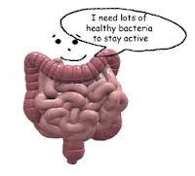
Altered Gut flora
Bacterial flora has a marked role in metabolism of some drugs.
Long term antibiotics may kill normal flora and affect drug absorption.
Ex : erythromycin and digoxin
40% or more of the administered digoxin dose is metabolized by the intestinal flora. Co-administration of antibiotics leads to increase in digoxin levels.
Notes:
Broad spectrum antibiotics → potentiate anticoagulants by reducing synthesis of vitamin K

Slide 26
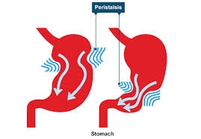
Altered gastric emptying
Metoclopramide (antiemitic)
Increase absorption of cyclosporine due
to the increase of stomach empting time
Increase the toxicity
of cyclosporine
Notes:
Broad spectrum antibiotics → potentiate anticoagulants by reducing synthesis of vitamin K

Slide 27
Atropine/opiods → reduce absorption of drugs
Purgatives → decrease absorbtion of digoxin
Increase in gi motility & decrease the time available for co-administered drugs to be absorbed
Psyllium + Fibre + fluid
→
Notes:
Broad spectrum antibiotics → potentiate anticoagulants by reducing synthesis of vitamin K
atropine/opiods → reduce absorption of drugs by delaying gastric emptying

Slide 28
Distribution Interactions
There is an important factor :
Vd
Protein binding interactions :
- unbound molecules remain free and pharmacological active.
- bound molecules are pharmacological inactive.
Some drugs may compete others for binding to protein depending on affinity
and concentration.

Slide 29
1. Displacement from tissue binding sites
Quinidine given to a patient on digoxin
Displacement from
tissue binding site
Displacement from
protein binding site
Impaired renal excretion
Notes:
Drugs enter the vascular compartment and get distributed into various tissues

Slide 30
2. Displacement from plasma protein binding
Can be clinically important if 2 criteria are fulfilled
Drug should be highly protein bound (>90%)
Low apparent volume of distribution
Precipitant drugs involved
Salicylates
Phenylbutazone
Sulfonamides
Notes:
Warfarin (99% bound v-9l), phenytoin (90% v-35l)

Slide 31
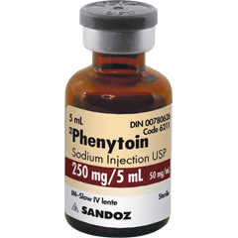
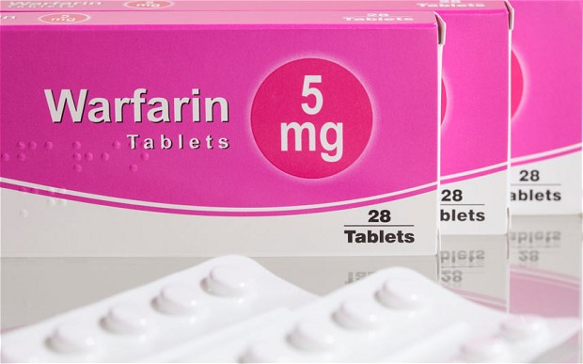
Warfarin (99% bound) and Phenytoin (90% bound)

Slide 32
Distribution interactions
Are those where the distribution pattern of the object drug is altered :
The major mechanism for distribution interaction is alteration in protein-drug binding.
Competitive displacement interactions
Displaced drug Displacer
Anti coagulants | Phenylbutazone, chloral hydrate | Increased clotting time. increased risk of hemorrhage.
Tolbutamide | Sulphonamides | Increased hypoglycemic effect.

Slide 33
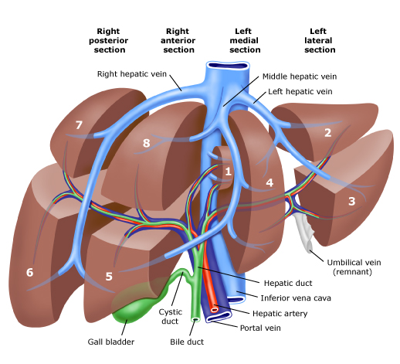
Metabolism (biotransformation) Interactions
Most drugs are chemically altered within Liver to less toxic and less lipid-soluble metabolites.
Hepatic metabolism has two pathways :
Phase 1 (modification)
Phase 11 (conjugation)

Slide 34
METABOLISM INTERACTIONS:
Are those where the metabolism of the object drug is altered.
Mechanisms of metabolism interactions include:
1.Enzyme induction:
Increased rate of metabolism.
2.Enzyme inhibition:
Decreased rate of metabolism. It is the most significant interaction in comparison to other interactions and can be fatal.

Slide 35
METABOLISM INTERACTIONS
1.ENZYNE INDUCTION
CORTICOSTEROIDS, ORAL CONTRACEPTIVES, COUMARINS, PHENYTOIN | BARBITURATES | DECREASED PLASMA LEVELS; DECREASED EFFICASY OF OBJECT DRUGS
ORAL CONTRACEPTIVES, ORAL HYPOGLYCAEMICS | RIFAMICIN | DECREASED PLASMA LEVELS
2.ENZYME INHIBITION
TYRAMINE RICH FOOD | MAO INHIBITORS | ENHANCED ABSORPTION OF UN METABOLISED TYRAMINE.
COUMARINS | METRANIDAZOLE PHENYL BUTAZONE | INCREASED ANTI COAGULANT ACTIVITY.
ALCOHOL | DISULPHIRAM, METRONIDAZOLE | INCREASED IN PLASMA ACETALDEHYDE LEVELS

Slide 36
Metabolism
Enzyme Induction
S No. | Precipitant drug | Object drug
1. | Alcohol | Warfarin, Phenytoin
2. | Barbiturates | Chlorpromazine, Phenytoin
3. | Phenytoin | Tolbutamide
4. | Rifampicin | Warfarin, Tolbutamide
5. | St. John’s Wort | Carbamazepine, SSRIs, Warfarin
Notes:
Interaction in whcich one drugs inhibits or induces the metab of the other drug can occur btween 2 drugs being metabolised by d same enzyme. However it doesn preclude d possibility of interaction btwen 2 drugs bein metabolised bybdiff enzymes
Theo inhibited by diltiazem
increase the amount of endoplasmic reticulum in hepatocytes
increases the content of CYP450

Slide 37
Metabolism
Enzyme Inhibition
S No. | Precipitant Drug | Enzyme | Object drug
1. | Allopurinol | Xanthine Oxidase | Azathioprine
2. | Carbidopa | Dopa decarboxylase | L-Dopa
3. | Disulfiram | Aldehyde dehydrogenase | Alcohol
4. | MAO Inhibitors | Monomine Oxidase | Amine containing foods

Slide 38
Enzyme Inhibition
S.no | Precipitant drug | Object drug | Effect
1. | Cimetidine | Diazepam | CNS effects
2. | Macrolides | Theophylline | Cardiac toxicity
3. | Metronidazole | Alcohol | Disulfiram like action
4. | Chloramphenicol | Tolbutamide | Hypoglycemia
Notes:
Interactions r stereoselective-phenylbutazone inhibits the metab of S isomer of warfarin but increases d clearance of d R isomer. However no effect on the racemic mixture

Slide 39
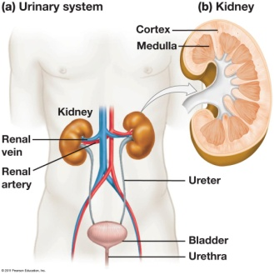
Excretion Interactions
Most drug are excreted in Urine or Bile.
Some drugs are reabsorbed from renal tubules or enterohepatic recirculation. (E.g. penicillins and oral contraceptives.)
Some drugs are excreted in acidic urine, so changing urine PH will affect there serum level.
These interactions are rare.

Slide 40
EXCRETION INTERACTIONS
Are these where the excretion pattern of the object drug is altered. Major mechanisms of excretion interactions are-
Alteration in renal blood flow
Alteration of urine PH
Competition for active secretions
Forced diuresis

Slide 41
EXCRETION INTERACTIONS
1.CHANGES IN ACTIVE TUBULAR SECRETION
PENCILLIN,CEPHALOSPORINS,NALIDIXIC ACID | PROBENICID | ELEVATED PLASMA LEVELS OF ACIDIC DRUGS
2.CHANGES IN URINE PH
AMPHETAMINE | ANTACIDS,THIAZIDESACETAZOLAMIDE | INCREASED PASSIVE REABSORPTION OF BASIC DRUGS.INCRESED RISK Of TOXICITY
3.CHANGES IN RENAL BLOOD FLOW
LITHIUM BICARBONATE | NSAIDS | DECREASED RENAL CLEARANCEOF LITHIUM.RISK OF TOXICITY

Slide 42
Excretion
S. No. | Precipitant Drug | Object Drug | Result
1. | Probenecid | Penicillin | Penicillin Retention
2. | Quinidine | Digoxin | Digoxin Toxicity
3. | Salicylates | Methotrextate | Methotrexate toxicity
4. | Salicylates | Uricosuric Drugs | Reduced Uricosuria

Slide 43
Pharmacodynamic interactions:
Are those in which the activity of the object drug at its site of action is altered by the precipitant. Such interactions may be direct or indirect.
These are of two types
1.Direct pharmacodynamic interactions. 2.Indirect pharmacodynamic interactions.

Slide 44
DIRECT PHARMACODYNAMIC INTERACTIONS
In which drugs having similar or opposing pharmacological effects are used concurrently.
The three consequences of direct interactions are 1.Antagonism.
2.Addition or summation.
3.Synergism or potentiation.

Slide 45
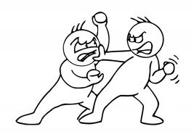
Pharmacodynamic Interactions
These interactions occur when the pharmacodynamic effect of the drug is alter by another drug, chemical ,or food element, producing an antagonistic, synergistic , or additive effect
A) Direct Pharmacodynamic Interactions
1. Antagonism at same site
● Opiates with Naloxone
● Warfarin with Vitamin K

Slide 46
2. Synergism at same site
● Effects of depolarising skeletal muscle relaxants potentiated by antibiotics like aminoglycosides, polymixin B
3. Summation of similar effects at different sites
● Effect of alcohol as a depressant potentiated by other
centrally acting drugs
● Effect of trimethoprim and sulfamethoxazole

Slide 47
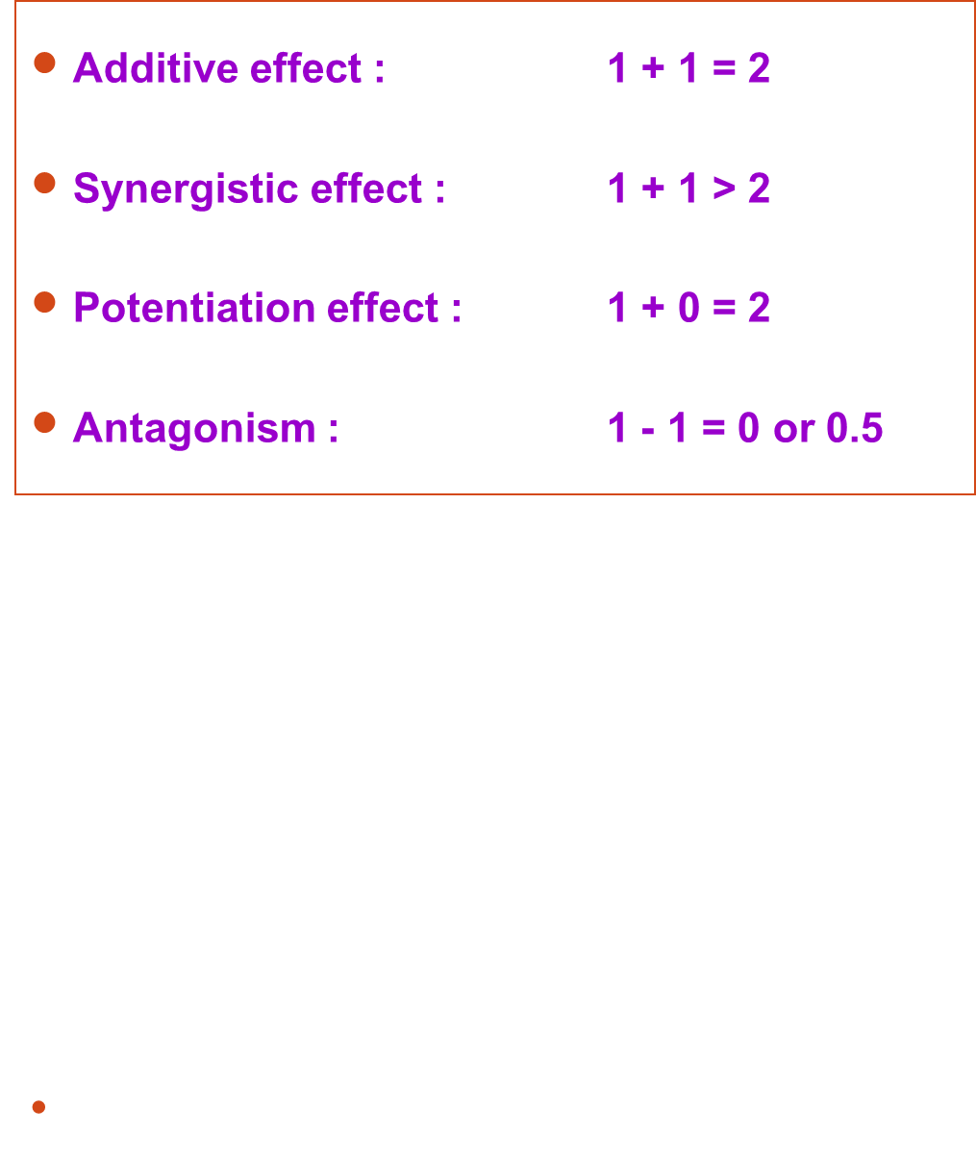

Slide 48
Antagonism:
The interacting drugs have opposing actions
Example: Acetylcholine and noradrenaline have opposing effects on heart rate.
Addition or summation:
The interacting drugs have similar actions and the resultant effect is the some of individual drug responses
Example:CNS depressants like sedatives and hypnotics,…etc
Synergism or potentiation:
It is an enhancement of action of one drug by another
Example: Alcohol enhances the analgesics activity of aspirin.

Slide 49
Indirect pharmacodynamic interaction
In which both the object and the precipitant drugs have unrelated effects.but the latter in Some way alerts the effects of the former.
Example: salicylatesdecrease the ability of the platelets to aggregate thus impairing the Homeostasis if warfarin indused bleeding occurs.

Slide 50
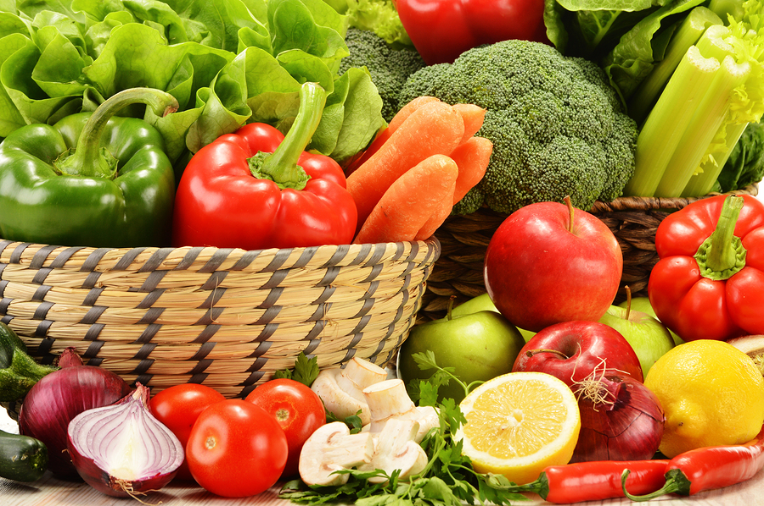
Drug -Food Interactions

Slide 51
INFLUENCE OF FOOD ON DRUG INTERACTION
Food effects the rate and extent of absorption of drugs from the GI tract.
Example: Many anti biotics should be given atleast 1hr before or 2hr after meals to achieve Optimal absorption.
The type of food may be important with regard to the absorption of concurrently administered Drugs.
Example: Dietary items such as milk and other dairy products that contain calcium may decrease absorption of tetracycline and flouroquinolone derivatives.
Diet also may influence urinary pH values affecting excretion.

Slide 52
Drugs effect food By
Food intake
Nutrient absorption
Nutrient metabolism
Nutrient excretion
Alteration in gut flora

Slide 53
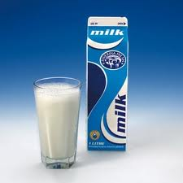
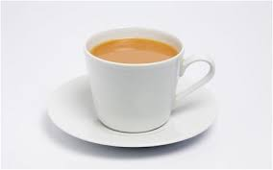

Milk
Fruit juice
Tea/coffee
Alcohol
Food- Drug
Erythromycin
Ketoconazole
Tetrcayclines
Iron supplements
iron absorbtion
theophylline
Wine-tyramine reaction
Notes:
Milk dissolves the coating of bisacody leading to pain and gastritis Mercaptopurine is a purine analog used for acute lymphoblastic leukemia and chronic myelogenous leukemias. Since it is inactivated by xanthine oxidase (XO), concurrent intake of substances containing XO may potentially reduce bioavailability of mercaptopurine. Cow’s milk is known to contain a high level of XO. This interaction may be clinically significant. Therefore most patients should try to separate the timing of taking mercaptopurine and drinking milk.
Fruit juice dec abs of erythromycin Orange juice inreases abs of ketoconazole dec that of celiprolol Grapefruit juice- enzyme inhibitor
Hesperidin, present in orange juice, is responsible for the decreased absorption of celiprolol

Slide 54
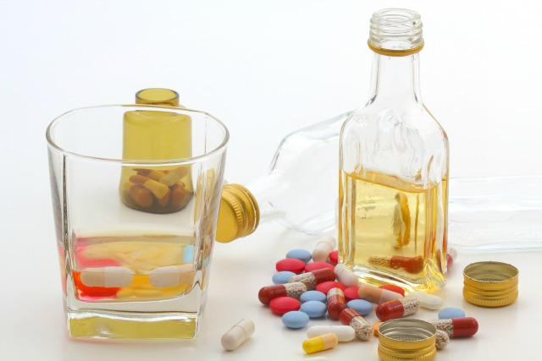
DRUG – ALCOHOL
INTERACTIONS

Slide 55
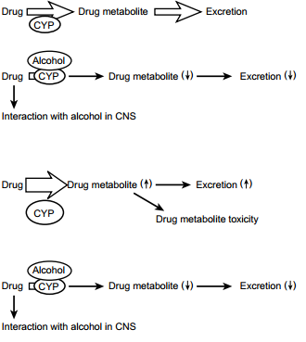
In the absence of alcohol
After moderate alcohol consumption
In chronic heavy drinkers who are sober
In chronic heavy drinkers who are intoxicated

Slide 56
 | Class | Names | Interaction | Effect
1. | Analgesics | Aspirin Acetaminophen | Increase gastric emptying Toxic metabolite of acetaminophen | Faster alcohol absorption Liver damage
2. | Anticonvulsant | Phenytoin | Induces phenytoin breakdown | Decrease effect
3. | Antihistamines | Chlorpheniramine | Increase CNS effect | sedation
4. | Antidiabetics | Chlorpropamide Glyburide Metformin | Increase risk of hypoglycemia | Unconsciousness Disulfiram like reaction Lactic acidosis
5. | BZDs | Diazepam | Increase effect | Sedation

Slide 57
INFLUENCE OF SMOKING ON DRUG INTERACTIONS
Smoking increases the activity of drug metabolizing enzymes in the liver, With the result that certain therapeutic agents.
Example: Diazepam, propoxyphene, theophylline, olanzapine.
Are metabolized more rapidly,and their effect is decreased.

Slide 58
Drug-Disease interactions
Drug-condition interactions occur when a drug worsens or exacerbates an existing medical condition
Nasal decongestants+ Hypertension Increased blood pressure
NSAID’S+ Asthmatic patients Air way obstruction
Minoxidil+ Heart failure Fluid rentation
Calcium channel blocker + Heart failure Negative inotropic activity
Nicotine + high blood pressure Increased heart rate
Beta blockers+ Heart failure Worsen asthma
Metformin + Heart failure Increased lactate level

Slide 59
CONSEQUENCES OF DRUG INTERACTIONS:
The consequences of drug interactions may be:
Major: Life threatening.
Moderate: Deteriotion of patients status.
Minor: Little effect.

Slide 60
REDUSING THE RISK OF DRUG INTERACTIONS
1.Identify the patients risk factors.
2.Take through drug history.
3.Be knowledge about the actions of the drugs being used.
4.Consider therapeutic alternatives.
5Avoid complex therapeutic regiments when possible.
6.Educate the patient.
7.Monitor therapy.

Slide 61
INFLUENCE OF ALCOHOL ON DRUG INTERACTION:
Chronic use of alcohol beverages may increases the rate of metabolism of drugs such as warfarin and phenytoin, probably by increasing the activity of hepatic enzymes.
Acute use of alcohol by non alcoholic individuals may cause an inhibition of hepatic enzymes.
Use of alcoholic beverages with sedatives and other depressants drugs could result in an excessive depressant response.

Slide 62
Role of pharmacist in avoiding drug interactions
Pharmacists in every practice setting need to be vigilant in monitoring for potential drug interactions and advising patients regarding drugs proper use, foods or beverages to avoid when taking certain medications and about disease conditions. It is imperative for pharmacists to keep up-to-date on potential drug-food interactions of medications, especially today’s new drugs, so that they may counsel properly to the patient.

Slide 63


